Slide 1


Farm to School Curriculum
Education Standards
Environmental Benefits Lesson (Next Generation Science Standards Elementary School)
5-ESS3-1 Obtain and combine information about ways individual communities use science ideas to protect the Earth’s resources and environment.
4-ESS2-2. Analyze and interpret data from maps to describe patterns of Earth’s features.
5-ESS2-1 Develop a model using an example to describe ways the geosphere, biosphere, hydrosphere, and/or atmosphere interact.
4-ESS3-1. Obtain and combine information to describe that energy and fuels are derived from natural resources and their uses affect the environment.

Slide 2

The Environmental Impact:
Local Food Kentucky

Slide 3
Objectives
Where does our food come from?
What role do fossil fuels play in your diet?
Notes:
Review objectives to be learned throughout this lesson.

Slide 4

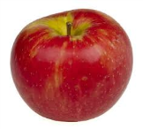
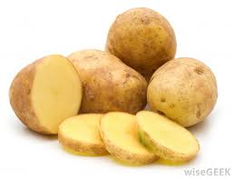
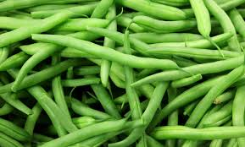



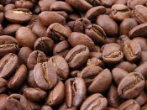

Central Asia
China, Turkey
Indonesia
Southern Spain
Mexico, Korea, Taiwan, Egypt
Columbia, China
Central America
Southern China
Northeastern India
Where in the world does grocery store food come from?
Notes:
Let’s start by talking about where our food usually comes from (before the grocery store).
Examples are below:
Apples- Central Asia
Bananas- Central America (Ecuador, Colombia, etc…)
Oranges- Southern China, Northeastern India
Potatoes-Idaho grows more potatoes than any other state, followed by Washington. (at least it’s in the USA ☺)
Green beans- China, Turkey, Indonesia
Corn- Mexico, Korea, Taiwan, Egypt, Colombia and China
Tomatoes- Southern Spain
This can sometimes bring us variety that is not grown locally (like bananas or pineapple), BUT for those types grown locally, buying them from far off places means they spend a lot of time traveling to your grocery store.

Slide 5
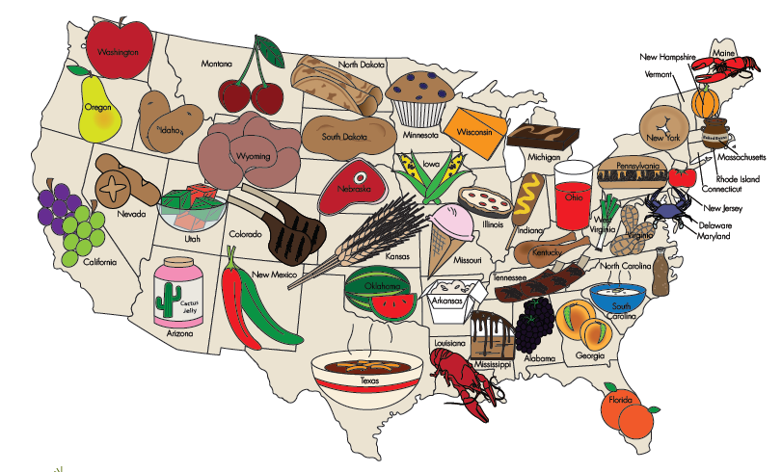
Where does your School Cafeteria Food come from?
Notes:
All food served in school cafeteria’s must be purchased from a grower in the United States, unless the food is not grown in this country.
MEET YOUR CAFETERIA MANAGER: If you cafeteria manager is available, ask him/her to come by the classroom for introductions. They can let you know when local food may be on the serving line.

Slide 6
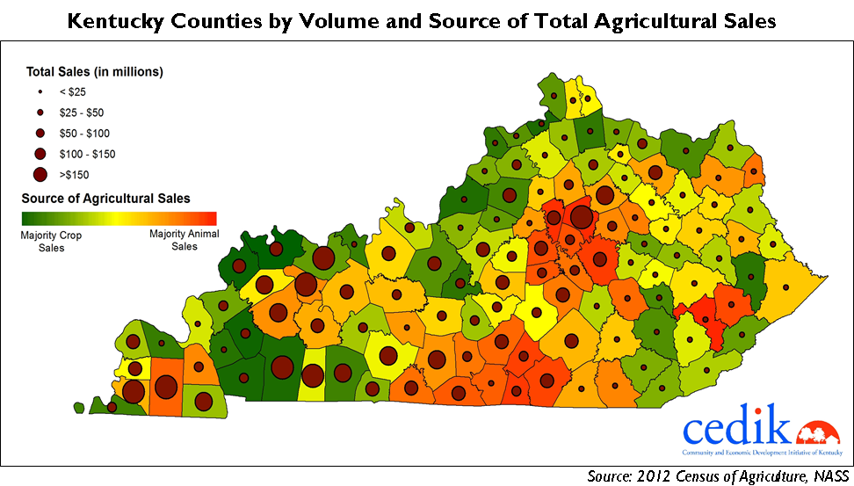
Where does food come from in KENTUCKY?
Notes:
We can grow almost anything in Kentucky. We may need to use a greenhouse to simulate warmer climates.

Slide 7

Where do we get Local Food in LEXINGTON?
Lexington Farmers Market
Bluegrass Farmers Market
KY Proud restaurants
School/Commu-nity/Back-yard Gardens
Some at local grocery stores
Notes:
This is an image of the Saturday Lexington Farmer’s Market Pavillion downtown.
Pass out trading cards in kit.

Slide 8
What do FOSSIL FUES have to do with this?
Notes:
What do Fossil Fuels have to do with this?
They are used in food transportation and packaging. The farther food travels, the more fuel used.
Food travels by plane, train, truck, even by boat when coming from far away. All these types of transportation need fuel, and using more fuel than is needed can hurt the environment.
Fuel is used for transportation, but also to make packaging for foods. Typically, the longer they have to travel, the more packaging is used. When you buy food at the farmers market, there is no packaging; and BONUS, there is less plastic to have to recycle or put into the garbage.
In 2005, food imports into California by airplane released more than 70,000 tons of CO2 (carbon dioxide), which is equivalent to more than 12,000 cars on the road.”

Slide 9

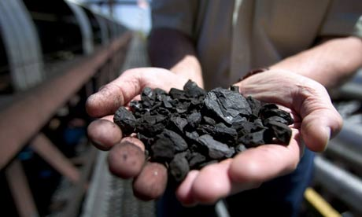

What are Fossil Fuels?
COAL
OIL
Natural Gas
Notes:
Fossil fuels are hardened remains of plant or animal life from some previous geological period that are preserved in the Earth's crust.
Fossil Fuels are Non-Renewable forms of Energy because they take millions of years to form!

Slide 10
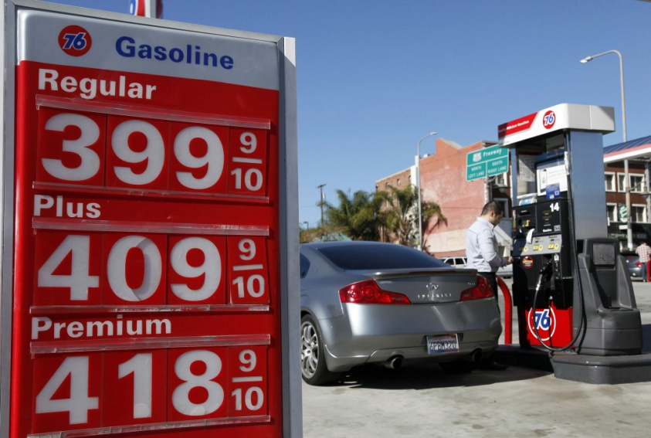
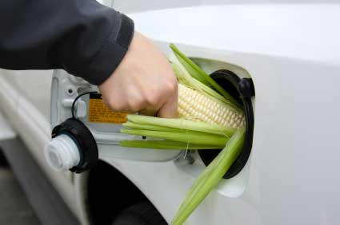
What Moves Our Food?
Petroleum OR Biofuel

Slide 11
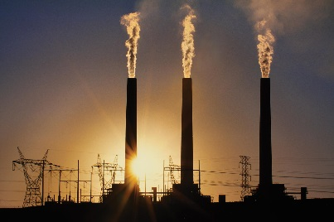
Atmospheric CO2 is now higher than it’s been for 650, 000 years and increasing rapidly
This graph, based on the comparison of atmospheric samples contained in ice cores and more recent direct measurements, provides evidence that atmospheric CO2 has increased since the Industrial Revolution. (Source: NOAA)

Slide 13
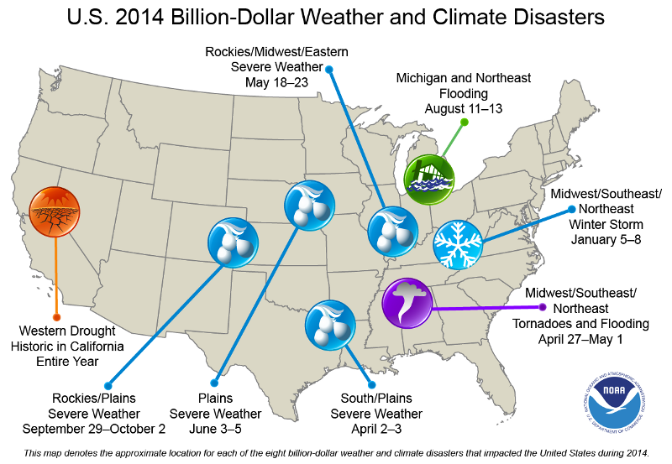

Slide 14
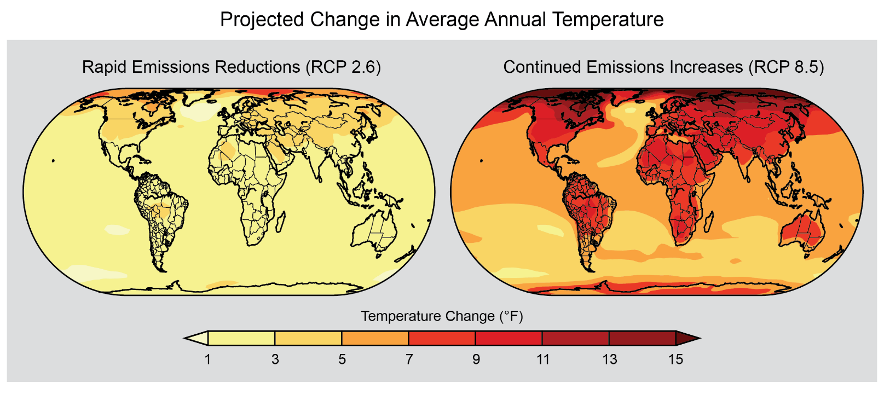
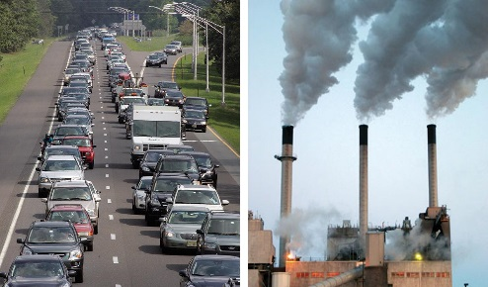
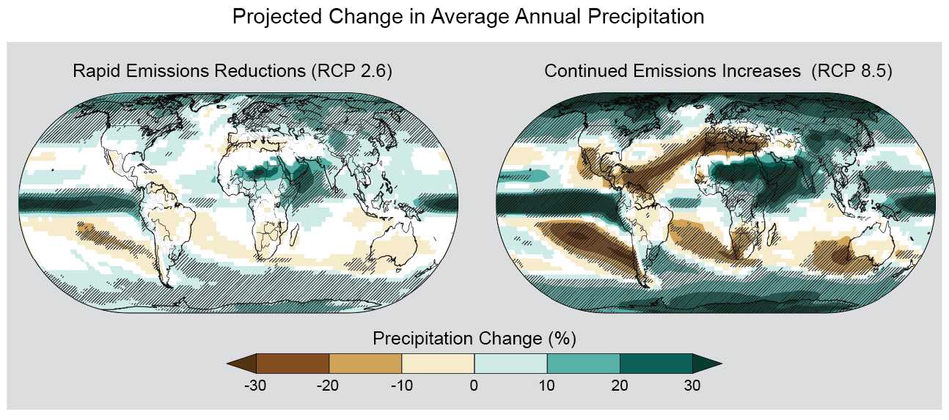

Slide 15
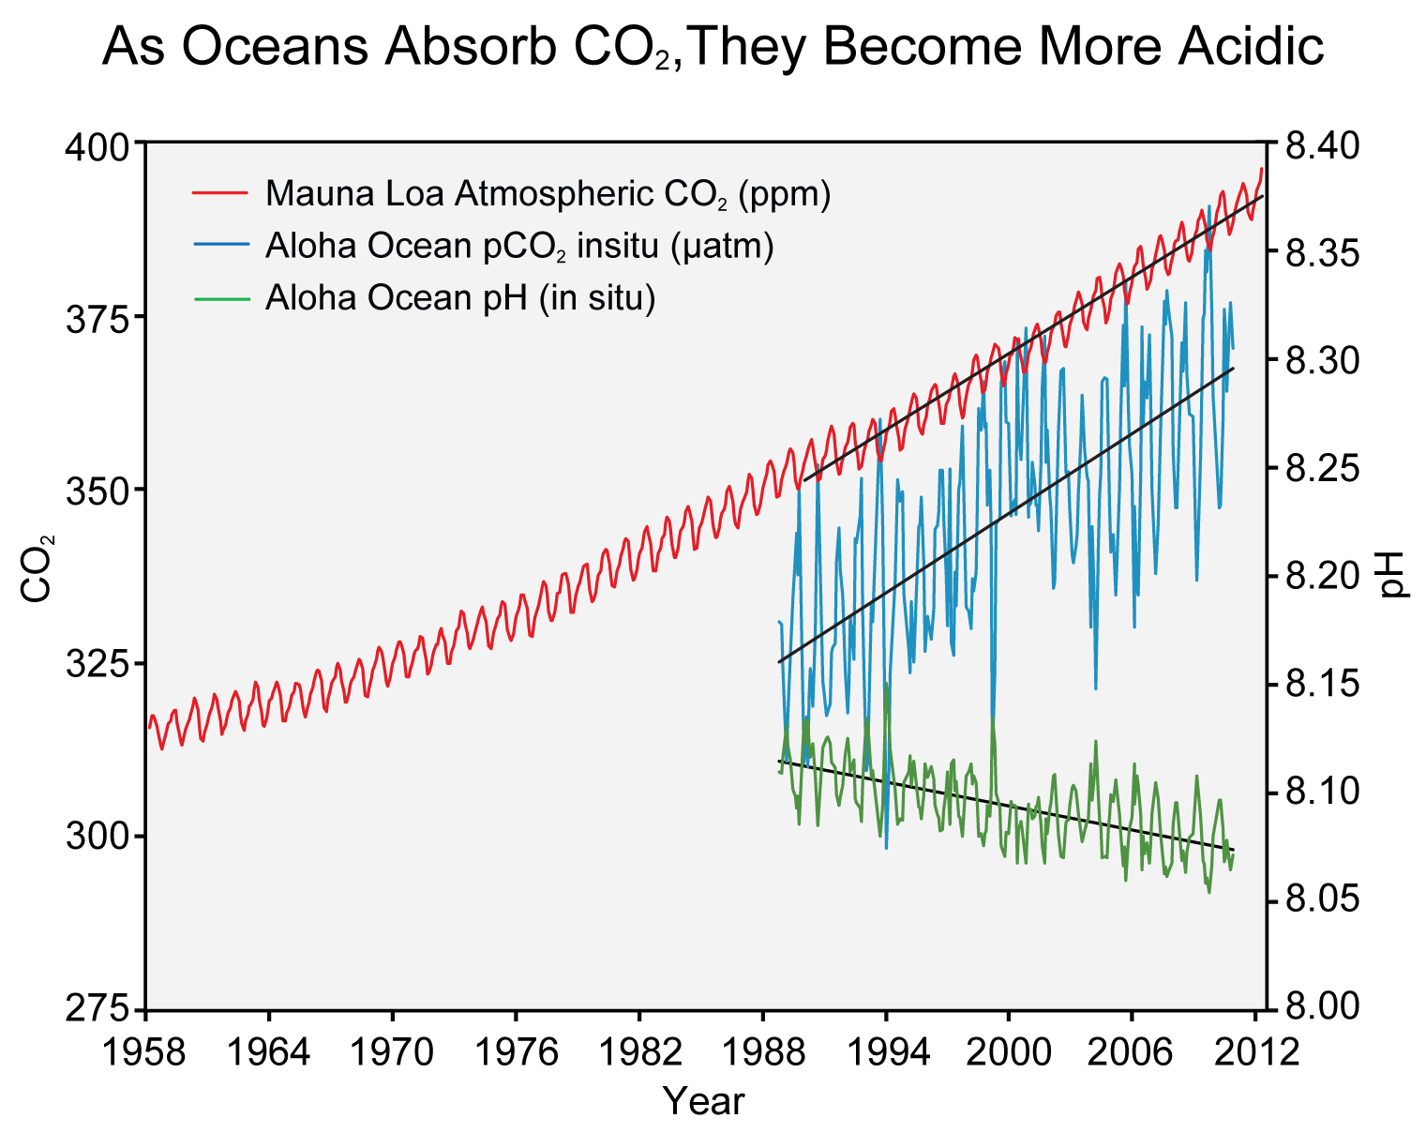
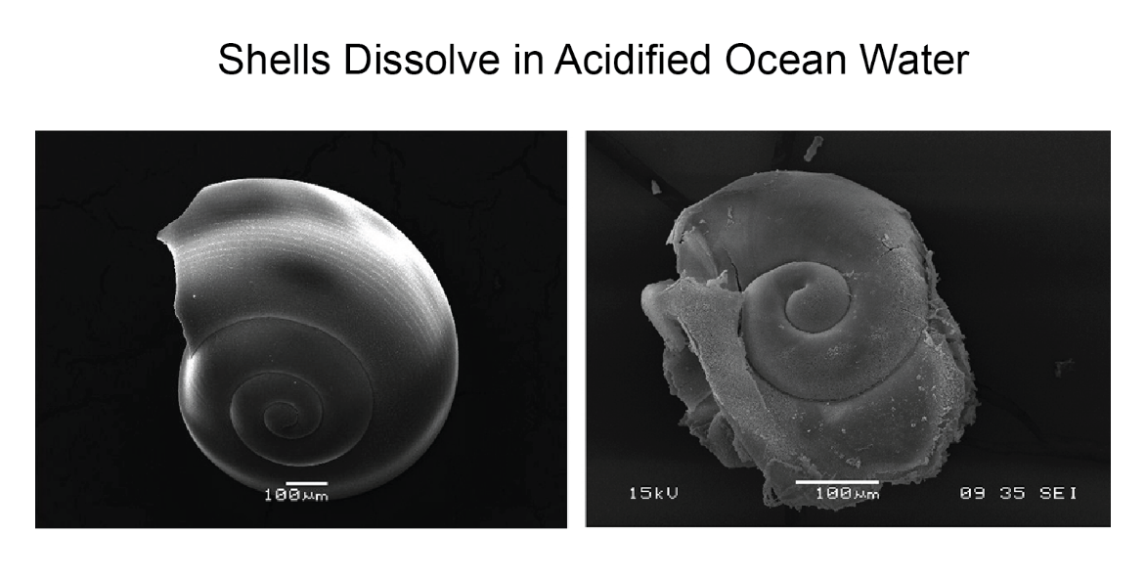
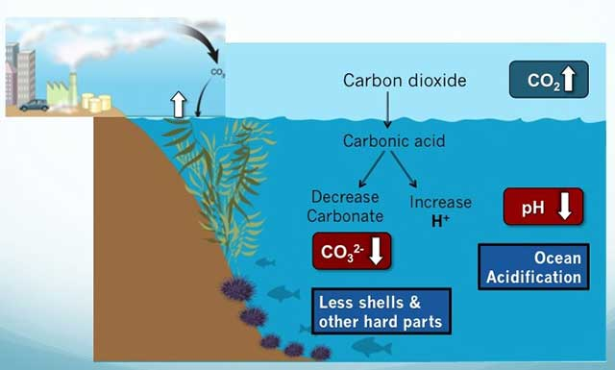

Slide 16
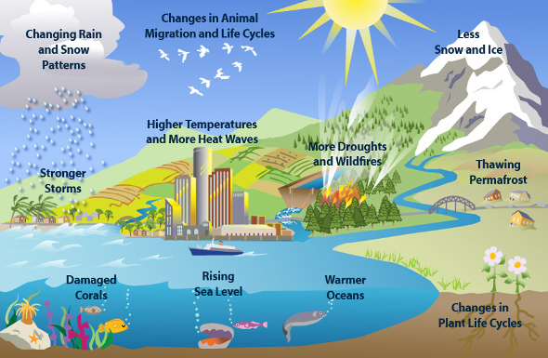
Why are fossil fuels Harmful?
Notes:
# 1 disadvantage of fossil fuels is pollution.
Burning any fossil fuel produces carbon dioxide (CO2), which contributes to the global climate change.
Mining coal can be difficult and dangerous. Strip mining destroys large areas of the landscape.
Coal-fired power stations need huge amounts of fuel, which means train-loads of coal almost constantly.
Greenhouse gas emissions from transportation accounts for about 27% of total U.S. greenhouse gas emissions, making it the second largest contributor of U.S. greenhouse gas emissions after the Electricity sector. (http://www.epa.gov/climatechange/ghgemissions/sources/transportation.html)

Slide 17
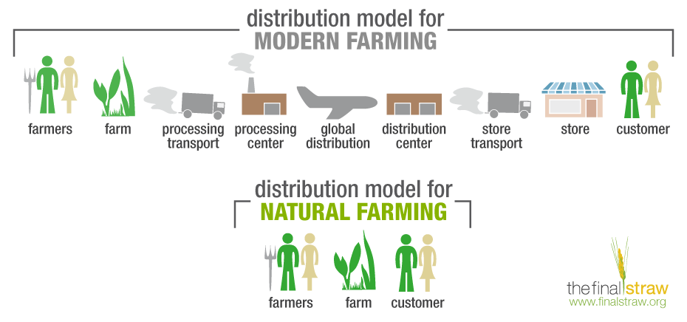
Which one is a better solution?
Notes:
Which way would use less fuel?
Which way would the food be fresher and therefore have more nutrients? (talked about in nutrition lesson)
Which way would make the farmer the most money? (talked about more in the economic lesson)
The BOTTOM one ☺!

Slide 18
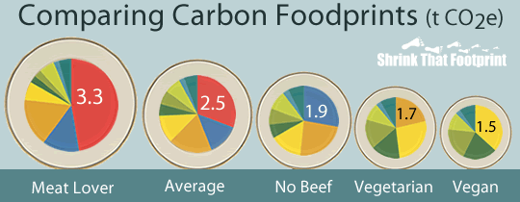

Notes:
Teachers will demonstrate the environmental impact of food production by engaging students in one or both activities below….
Activity 1: Food Miles
Materials Needed: Post-it Notes, Marker
Start by writing “50 Miles” on one note per student. This will represent miles in which food travels.
Have students form a circle by facing outward.
Give each student a post-it note which are labeled “50 Miles”.
Select one student to be the “transportation”. Have this student walk around the circle collecting the post-it-notes.
Once all notes are collected, add up the miles. This is roughly how many miles there food travels to get to them (Ex. 30 students x 50 miles = 1,500 miles).
After you discuss the impact of food miles, set up part 2.
Have students form a circle by facing outward.
Give each student a post-it note which are labeled “50 Miles”.
Tell the “transportation” student to begin collecting post-it-notes, but stop after 200 miles are collected. This can represent the local food markets found in the state.
Compare this to the number of miles collected in the first game. Less food miles equals more positive changes and lower emissions of greenhouse gases and other harmful toxins.
Activity 2- Food Travelogue
Teacher or students can bring a food product(s) to class with a product of origin sticker or label.
Discussion questions: How far did the product travel? What traveled the farthest? What had the shortest trip? Was anything grown locally?
Activity 3 – Food Miles at www.foodmiles.com

Slide 19
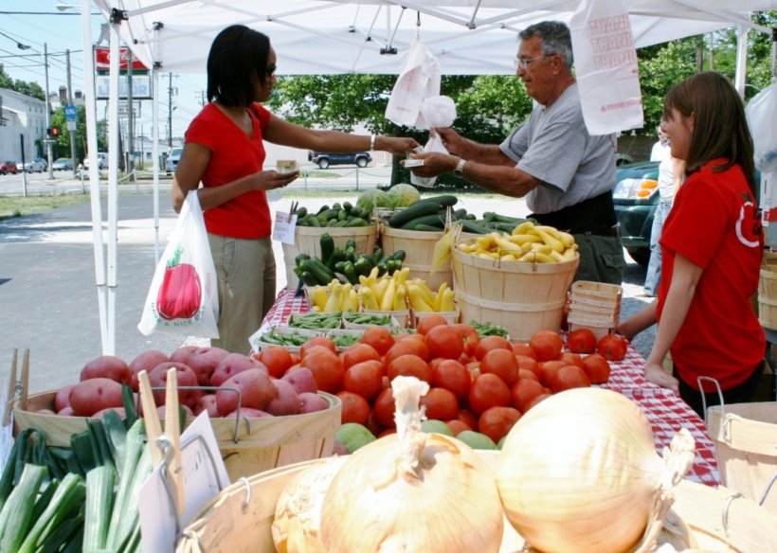
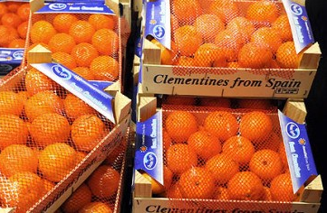
Local is Better!
Local (Kentucky) Food
More sustainable practices
Less transportation
Less pesticide use
Balances local demand
Less environmentally harmful equipment
Less packaging
Imported Food
Less sustainable practices
Dependent on fossil fuels
More transportation
More pesticide use
More packaging
Notes:
Local Food Production
Since food is grown close to home, local food production…..
Uses more sustainable agriculture--- a system of food and production that protects the environment. This meaning it reduces soil erosion, uses chemicals responsibly, finds ways to make farms profitable, invests in rural communities, and keeps food prices reasonable.
Less transportation- Since food is grown close, less money will be used for transportation cost
Less pesticide use (not all local is organic)
Balances demand based on local needs- Since crops are grown locally, the community farms know the needs of the community and can help by providing with these crops.
Involves less environmentally harmful equipment and practices- Because majority of the foods are grown on small family farms.
Imported Food
Usually grown farther away, and is less sustainable…
Dependent on fossil fuels-
Potentially more chemical fertilizers and pesticides (made with fossil fuels).

Slide 20
Activity:
Where Does Our Food
Usually Come From??

Slide 21
For each item, send someone to the board to guess
where the product usually is grown that we eat in
Kentucky!
Sometime there is more than one place in the world
that grows a fruit or vegetable. But often times, we
get the product from the same area.
All of these items where found in Walmart in October 2016 and came from the Western Hemisphere.

Slide 22

Where is the Western Hemisphere?

Slide 23
Where is the Western Hemisphere?

Slide 24
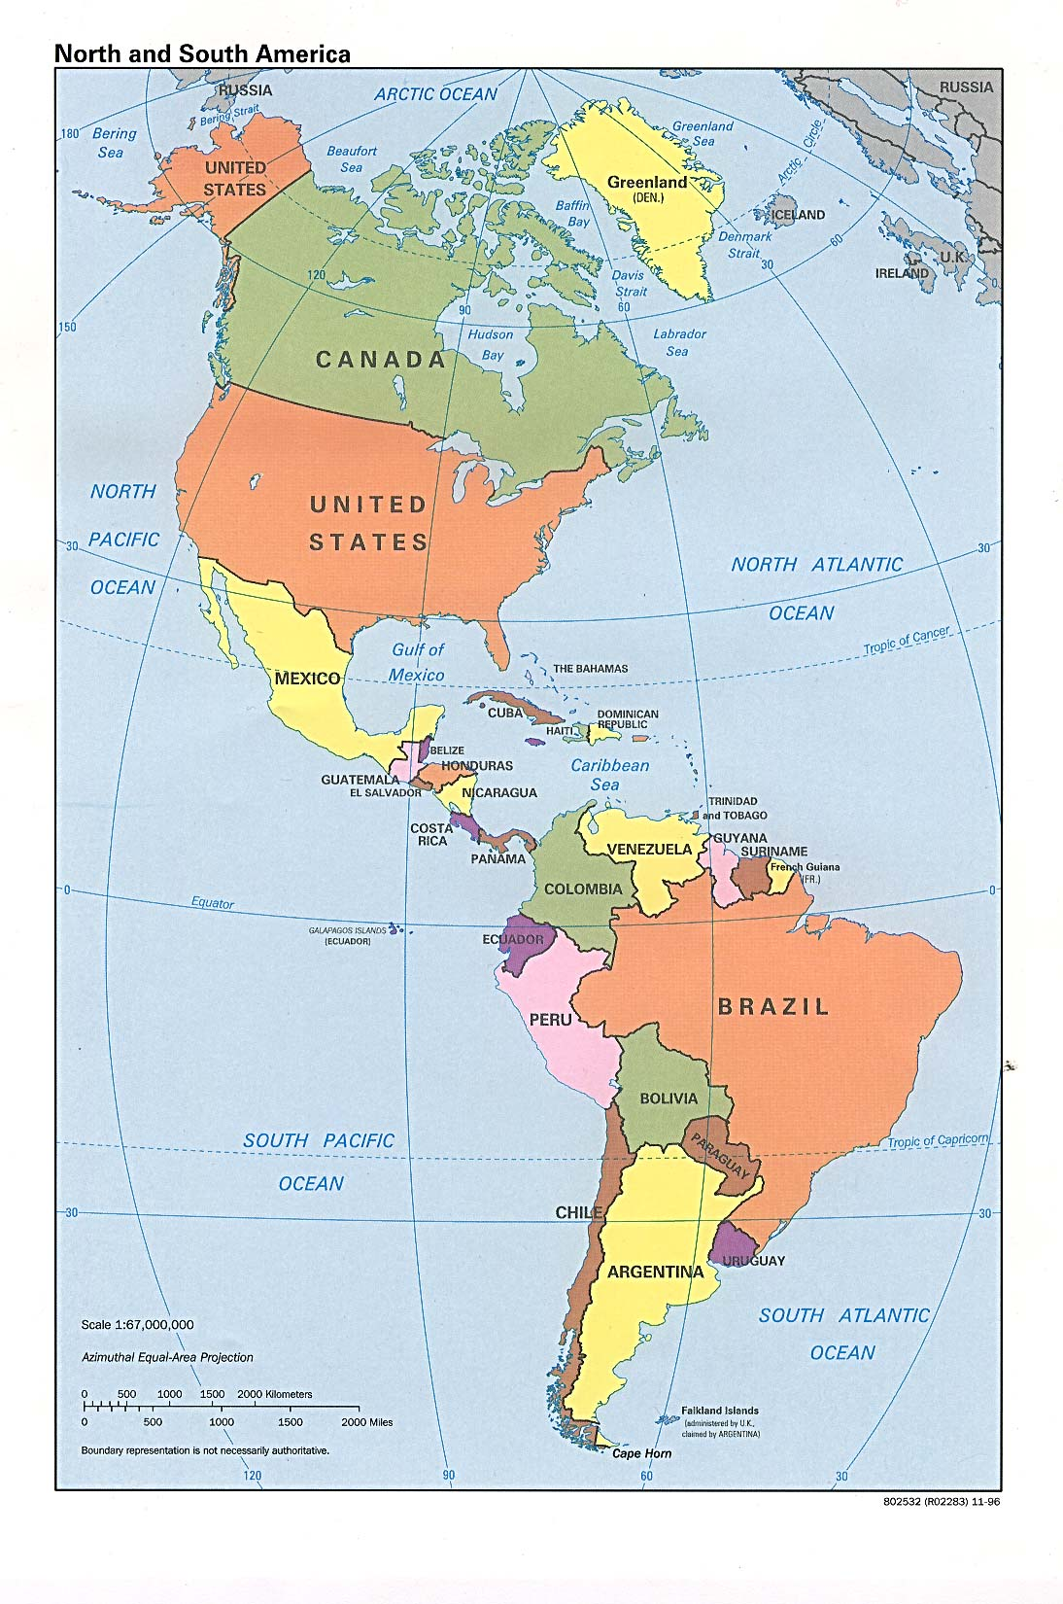
We Are Here!

Slide 25
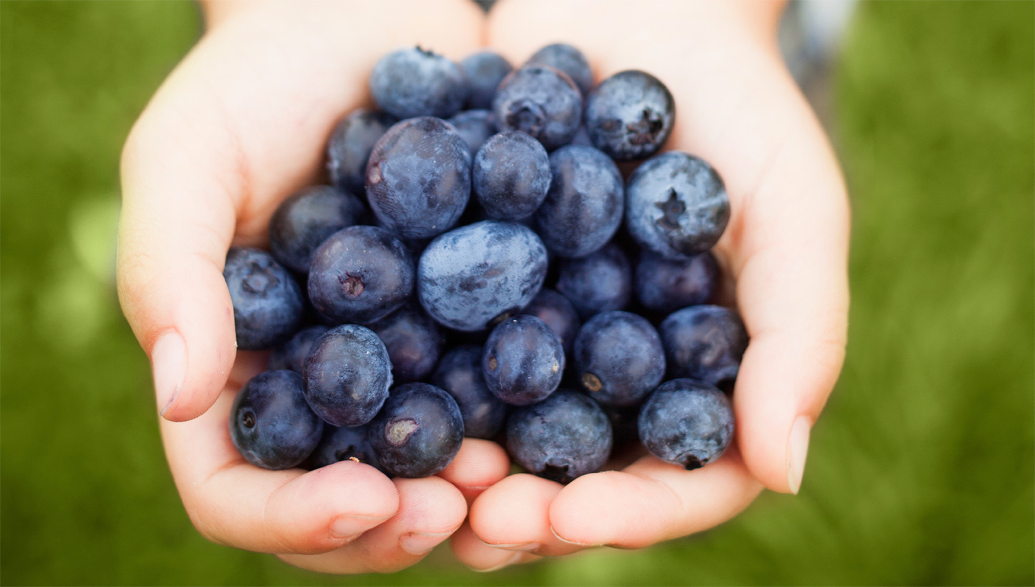
Blueberries

Slide 26
Where do blueberries come from?

Slide 27
Where do blueberries come from?
Peru
3,300 miles

Slide 28
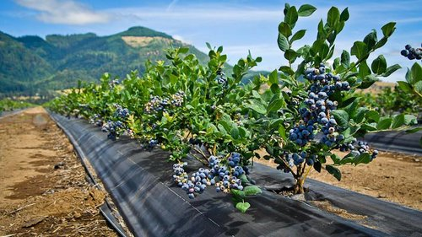

Slide 29
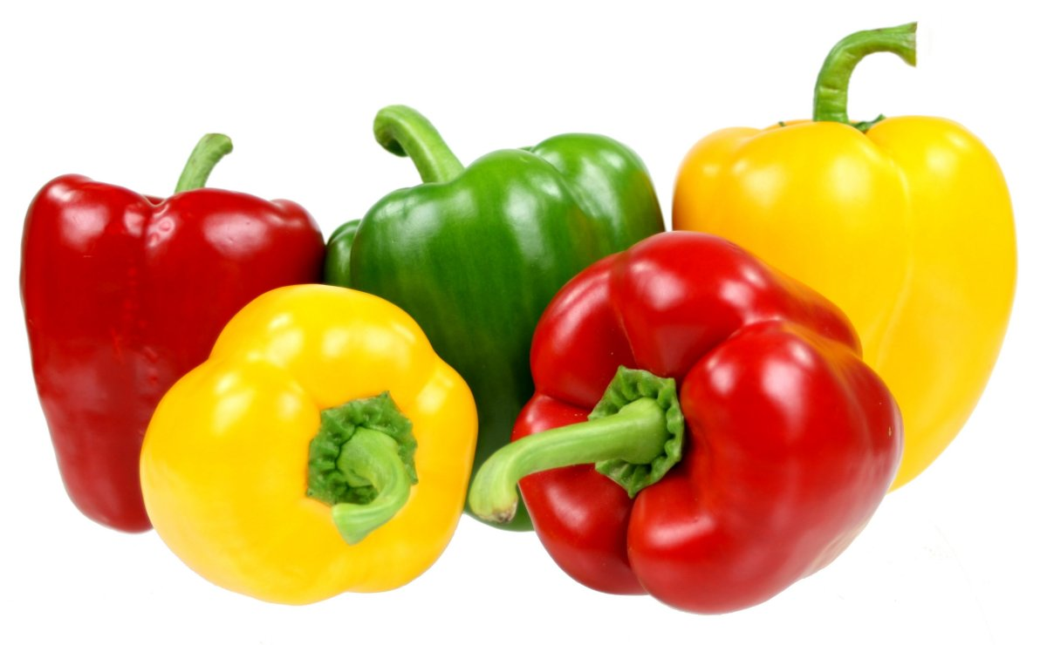
Bell Peppers

Slide 30
Where do bell peppers come from?

Slide 31
1,620 miles
Where do bell peppers come from?
Canada & Mexico
1,750 miles

Slide 32
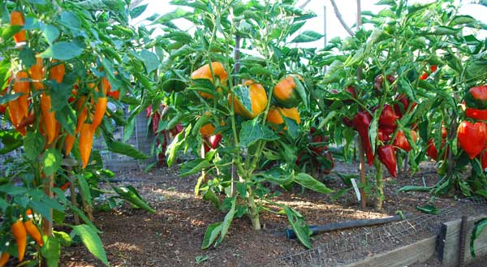

Slide 33
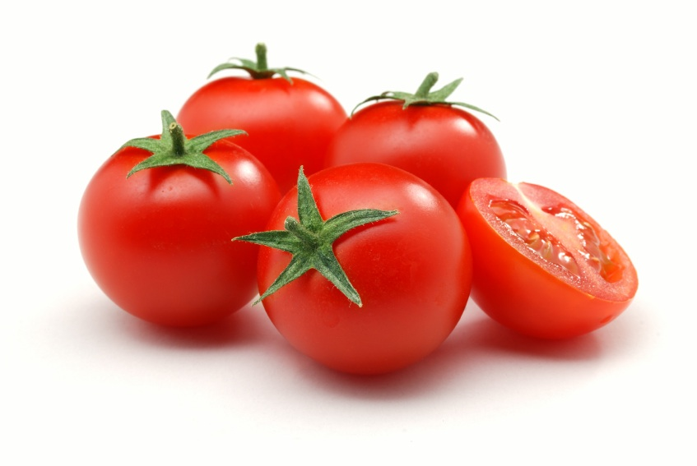
Tomatoes

Slide 34
Where do tomatoes come from?

Slide 35
Where do tomatoes come from?
Mexico
1,750 miles

Slide 36
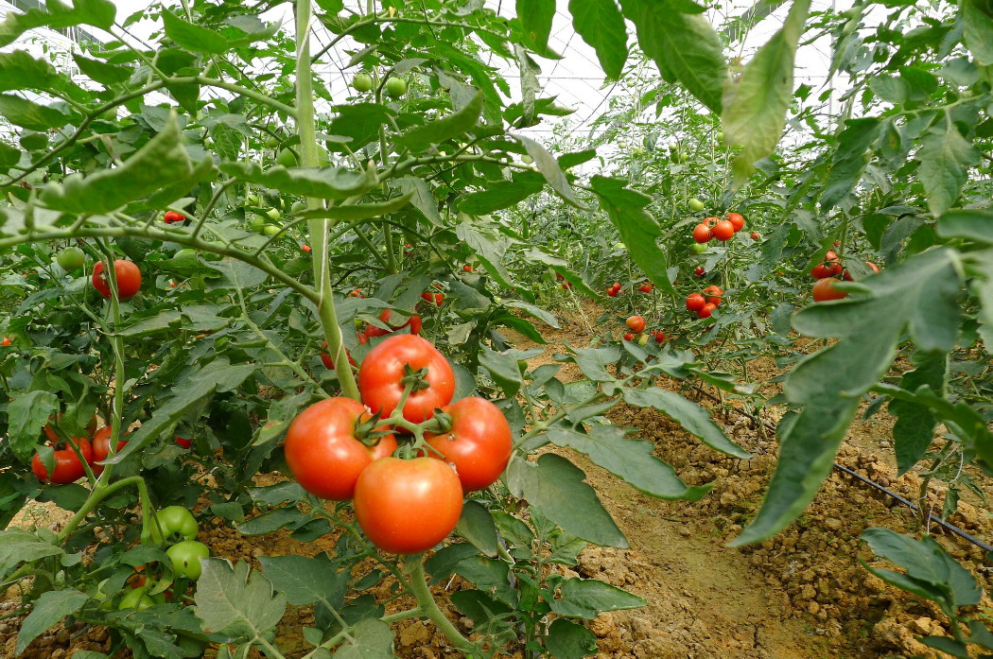

Slide 37

Cantaloupe

Slide 38
Where do cantaloupes come from?

Slide 39
1,740 miles
Where do cantaloupes come from?
Arizona

Slide 40
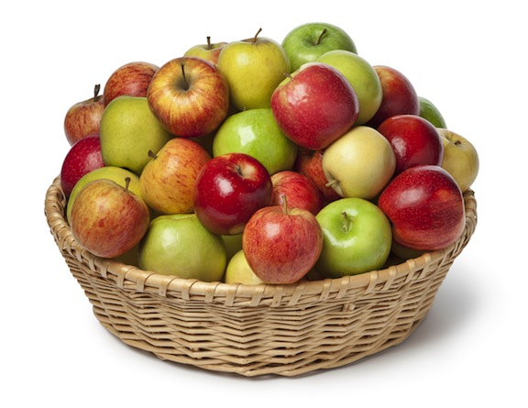
Apples

Slide 41
Where do apples come from?

Slide 42
2,360 miles
Where do apples come from?
Washington
State

Slide 43
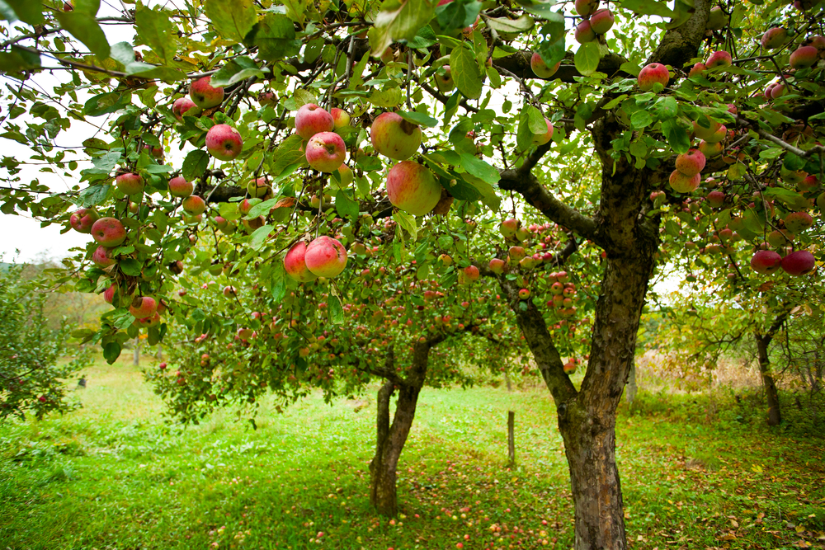

Slide 44

Human Nutrition Benefits
Eating local produce helps you to eat all of the Nutrients your body needs
Eating local foods helps minimize Nutrient Degradation
  Is an apple from Washington or Kentucky Healthier?
The longer food travels from farm
to consumer, the more nutrients
it loses.
Notes:
Nutients are “ingredients” of food or what foods are made of. There are 6 nutrient groups: FAT, CARBOHYDRATE, PROTEIN, VITAMINS, MINERALS, WATER.
Nutrient Degradation: When vitamins and minerals are lost by time, heat, light and air exposure. Focus on how local foods don’t suffer from this.
Fresh produce needs to fully ripen on the vine to get the most nutrients The longer they are in “transit” from farm to consumer, the more nutrients they loose.

Slide 45

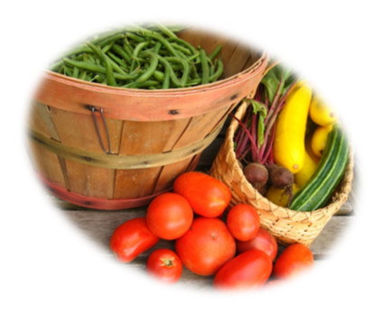
Economic Benefits
Farmers have a new place to sell their local food!
Local farmers get to keep more $MONEY$
That $MONEY$ stays
INSIDE the community!
Notes:
Quick explanation of an economy- The system by which goods and services are produced, sold, and bought that helps us determine how to use limited resources.
-The Farmer gets to keep more money because they are selling directly to the school. The food does not have to also be sold to processor, distributor, retailer first.
-For every $1 spent at a local business, 45 cents is reinvested locally while for every $1 spent at a corporate chain, only 15 cents is reinvested locally.

Slide 46
Resources
http://www.environmentforbeginners.com/content/view/106/1/
http://www.uvm.edu/vtvegandberry/factsheets/buylocal.html

