Slide 1
Show Me the Money
The Economic Benefits of Farm to Table

Slide 2
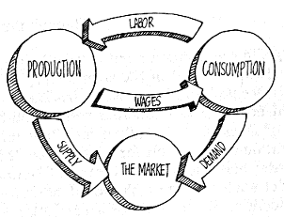
What is an Economy?
The system by which goods and services are produced, sold, and bought that helps us determine how to use limited resources.
Production- What gets made and how?
Distribution- How do we get things to people who want them?
Consumption- What do people want, how much, and what price?

Slide 3
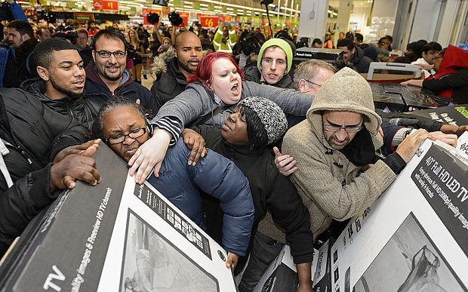
Supply and Demand
Supply
How much is available to us?
What price can it be sold for?
When supply is high, price is high so
business receives more revenue
Demand
How much do we want?
What price are we willing to pay for it?
When demand is high, price is often
low. Think Black Friday sales!
Example: Black Friday Shopping

Slide 4
Economics: Supply & Demand
Price
Supply
$1
Demand
1
Quantity
Notes:
Optional – explanation: We create Demand, based on how much we are willing to pay for an apple. ($1? $10?)
That is how an economic decision gets made.
Every time you or your parents decide to purchase something, they are telling the supplier (in this situation, an apple farmer) how much you want and how much you are willing to pay for it.

Slide 5
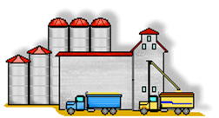
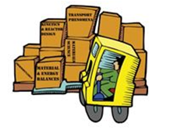
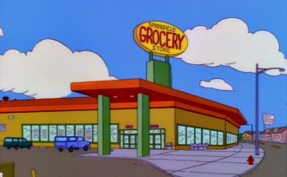
Economics: Supply Chain
Farmer
Farmer
Processor
VS.
Table
Distributor
YOU!
Retailer
YOU!
Notes:
Money Activity:
Materials List: 10 fake $1 bills, 1 piece of fruit, paper signs for each role to hold or hang around their necks
(kit available for check-out)
6 children are at the front of the room and have roles as a Farmer, Processor, Distributor, Retailer, School, or You (the Consumer).
The Farmer passes the apple to the Consumer through all of the other students; the Consumer passes the money through the chain of students. Each student/role takes $2 and the Farmer is left with $4.
Repeat with the Farm to School chain of students(take out the Processor, Distributor, Retailer); the Farmer gets to keep $8.

Slide 6
Farm to School Economic Benefits
Community
Business
Jobs
Farmers have a new place to sell their local food!
Local farmers get to keep more $MONEY$
YOU get to eat tasty, local, & healthy food!
That $MONEY$ stays INSIDE the community!

Slide 7
Profit Difference
We’ve learned about how selling food locally and to retailers has many different steps
.
But what is the difference in profit?
We’re about to find out!
Retailer
This Way
Farmers Market
This Way

Slide 8
You Crop Grower, You!
You have inherited 10 acres of land from a long lost relative.
You’ve decided to plant sweet corn on your farm, because it’s your favorite vegetable.
Your goal: Make the most money possible!
Follow along on your Crop Grower worksheet to figure out the best way to do that!

Slide 9
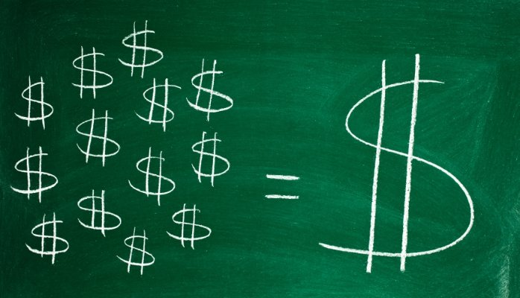
Costs of Sweet Corn Production
Ever heard of the saying, you have to spend money to make money? Well, it’s true!
To produce a corn crop, you will need to think about the following costs.
Seeds
Land/Fertilizer
Water
Labor

Slide 10
Costs, continued
What are our total costs? Remember, we have 10 acres.
Fill in the chart on your worksheet.
Calculate the total costs per acre.
In order to get the costs for 10 acres, what do we do?
Calculate the total costs for 10 acres.
COSTS | Cost Per Acre | Cost for 10 Acres
Seeds (Sweet Corn) | $100
Land/Fertilizer | $500
Water | $60
Labor (5 workers) | $600
TOTAL:
COSTS | Cost Per Acre | Cost for 10 Acres
Seeds (Sweet Corn) | $100
Land/Fertilizer | $500
Water | $60
Labor (5 workers) | $600
TOTAL:

Slide 11
Gross vs. Net Profit
Gross profit how much money you get for your crop before expenses. Essentially how much your crop is worth.
Assume we can sell 1 acre of sweet corn for $3,400 based on market prices (that fluctuate each year).
How can we sell the entire 10 acres of sweet corn for?
BUT… We had to spent $12,600 in costs of production.
Once we pay for those costs, how much is our sweet corn crop worth now? This is your net profit.
BUT WAIT!! Depending on where you sell your corn, you may have even more expenses!!

Slide 12
Time to Sell!
Farmer
Let’s say we want our sweet corn to be sold at Walmart.
When we sell to a retail store, what other costs do we face?
Everyone who touches the corn gets a piece of the profit.
Think back to the Supply Chain.
Who gets money when you sell to a retail store?
When you sell to a retailer, the farmer (you!) only gets 16% of the profit.
What’s your net profit now? Set up your equation like this:
Total Value of 10 Acre Sweet Corn Crop after Costs * .16
Processor
Distributor
Retailer
YOU!

Slide 13
Time to Sell: Take Two!
Let’s say we want to sell our sweet corn at the local Farmers Market.
Let’s look at the supply chain.
Who else gets money?
When farmers sell at the Farmers Market, they keep 100% of the profit.
What’s your net profit now?
Farmer
Table
YOU!

Slide 14
Which is best economically?
Let’s compare net profits.
How much did you make selling your crop to Walmart?
How much did you make selling your crop at the Farmers Market?
Farmers Market | $21,400
Walmart | $3,424
Difference | $17,976

Slide 15
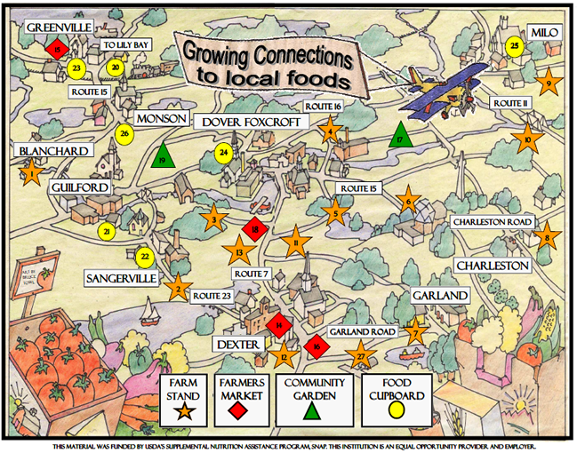
Do you know where to buy local?
Farmers Market
Farm stands
Some grocery stores
Gardens
Orchards
Farms
Food Banks

Slide 16
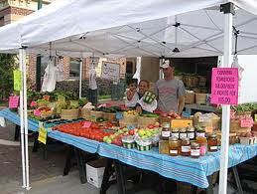
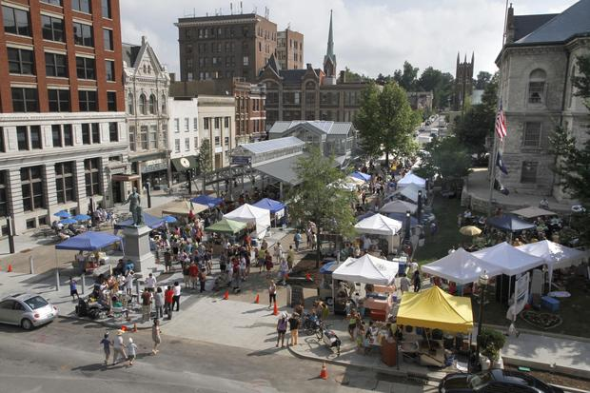
Have you been to the Farmers Market?
249 West Main Street, Lexington, KY 40507

