Slide 1
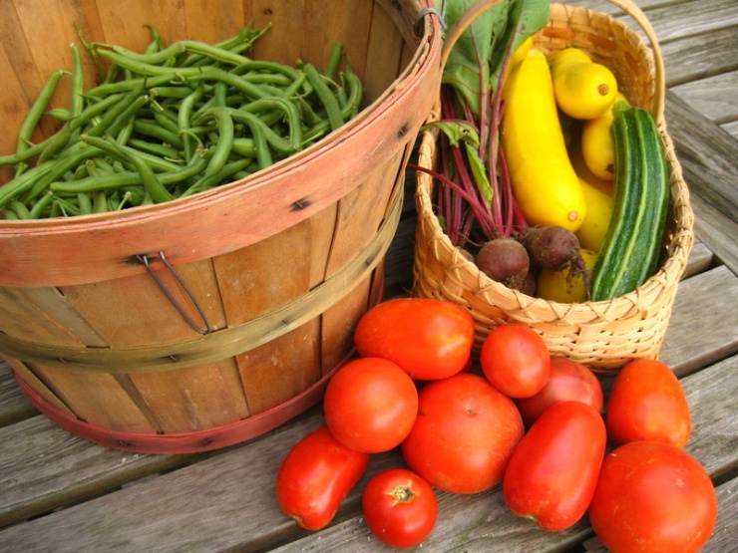
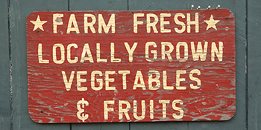
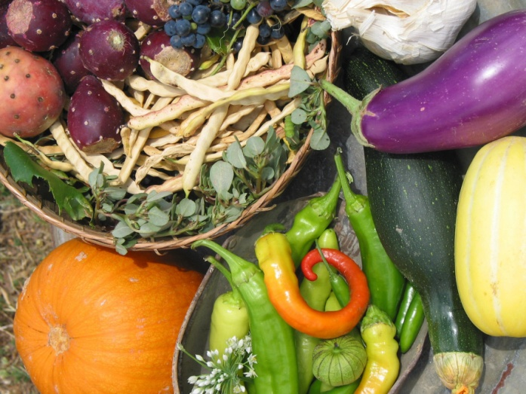
How is Local Food Good for Our Economy?
Notes:
Hi all—my name is (insert name here) and we are going to be talking about why local food is good for the economy.
First, we are going to play a name game. We are going to go around the room, say our first name and then pick a fruit or vegetable that has the same first letter as our name. Example, my name is Reena and a vegetable that starts with R is Radish!
After the name game stay on slide 1 and ask: Does anyone know what local food is? Has anyone see the Kentucky Proud or KY local in the grocery store? What about in your school?
Well, when you see KY Proud or KY local or see you have a farm to school meal in your cafeteria—that means the food you are eating has been grown by a farmer in KY.

Slide 2
Farm to School Curriculum
Education Standards
Economic Benefits Lesson (Social Studies Standards Grade 4)
Academic Expectations 2.18 Students understand economic principles and are able to make economic decisions that have consequences in daily living.
Enduring Knowledge
A variety of fundamental economic concepts impact individuals and groups.
Markets enable buyers and sellers to exchange goods and services.
Individuals, groups and businesses demonstrate interdependence as they make economic decisions about the use of resources (e.g., natural, human, capital) in the production, distribution, and consumption of goods and services.
Skills and concepts
Demonstrate an understanding of markets: explain how goods and services are/were exchanged.
Notes:
At the end of this lesson you should be able to understand how goods and services are exchanged as well as understand basic economic principles and how to make meaningful economic decisions.
(More for teacher than for students.)

Slide 3
What is an Economy?
The system by which goods and services are produced, sold, and bought that helps us determine how to use limited resources.
Everything we MAKE (or GROW)
Everything we BUY
How resources are USED
Notes:
Ask and respond:
1. What is an economy?
An economy is the system by which goods and services are produced, sold, and bought that helps us to determine how we use limited resources.
2. What are goods? Can you give some examples?
Goods are the material products we make or grow to sell. Examples could be apples, iphones, clothes, anything you can touch, etc.
3. What are services? Can you give some examples?
Services are actions. In an economy, they are actions that consumers spend money on. Examples of service providers could include doctors, lawyers, teachers, hairdressers, etc.
4. What are some examples of limited resources?
Oil, coal, wood, etc.

Slide 4
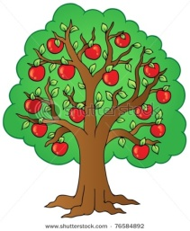
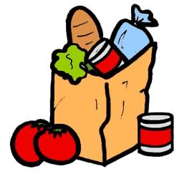
Economics
Production (What gets made and how?)
Distribution (How do we get things to people who want them?)
Consumption of goods and services (What do people want, how much, and what price?)
The Big Question:
How can we satisfy unlimited wants …with limited resources?
Notes:
Now that we know what an economy is we are going to talk about economics.
Economics is the study of the economy and its three major parts.
Production – example: growing apples on a farm
Distribution – example: farmer sells apples to school
Consumption – example: students eat local apples
We have one big question we want to answer with economics: How can we satisfy unlimited wants with limited resources?
We will start with the apple example… we have one apple and 25 people who want that apple… how do we determine who gets the apple?
Ask the kids who they think will get the apple. Try to get them all involved.
If they are having a difficult time, ask them in terms of money. Give them examples were John will pay 10 dollars for the apple and Sue will pay 5 dollars for the apple.
Of course! The person who pays the most for the apple will get the apple!

Slide 5
Economics
Helps us decide:
What goods & services get produced
How they are produced
Who gets them
Who answers all of these questions?
YOU answer these questions as a CONSUMER
Notes:
Economics helps us decide:
1. What goods and services get produced?
2. How they are produced?
3. Who gets them?
But in the end, it is the consumer who answers these questions.
What is a consumer? Anyone who purchases goods and services – also called the customer.
Are you all, as students, consumers?
You, whether or not you know it, are a consumer. You might be thinking…. I don’t have that much money, how can I be a consumer?? Well you have what is called purchasing power. What do you think purchasing power is?
Purchasing power is the ability to influence what is bought and sold in an economy.
How do you all, as children without much money, have purchasing power?
You all influence your parents and caregivers to buy or not buy certain things! When you beg and beg for that new video game for Christmas, or get to pick our your new school clothes, or convince your parents to have a pizza night --- all these actions are influencing the economy.

Slide 6
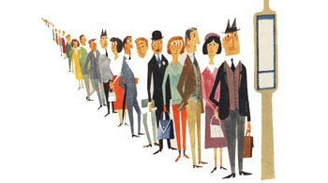
Intro to Supply & Demand
Supply
How much is available to us?
What price can it be sold for?
Demand
How much do we want?
What price are we willing to pay?
Notes:
What do you think supply means?
Supply is how much of something that is available to us. By knowing how much is available to us we know how to price that item.
What do you think demand means? Demand is how much we as the consumer want of that item and that determines how much we are willing to pay for an item.
Let’s go back to talking about our apple scenario. We create demand based on how much we are willing to pay for an apple. Would you rather pay $1 for an apple or $10? The amount of supply also affects the price. If a farmer has a lot of apples, would he make the price high or low? He will sell them for a lower price.
Now… what would happen to the price if the farmer only grew 10 apples but 100 people wanted them? What would happen to the price if the farmer grew 100 apples and only 10 people wanted them? The price would go up!
This is the balancing act…
Now that we know supply and demand—let’s do a couple of examples:
Ask: a new iPhone is released and they only make a few…
What does the demand look like? High
What is the supply? Low
Will the price be high or low? HIGH
Let’s think about the opposite…
It’s winter time. You want a pair of flip-flops and the store has plenty.
Will the demand be high or low? Low—because it’s the winter time.
Will the supply be high or low? High—the store has a lot, that might be because they have a lot left over or because the demand is so low.
What does the price look like? The price will be low because they have a lot product and they want to get rid of it.
However, there are some cases where it doesn’t matter what the supply is, if the demand is high enough you can charge whatever you want…
Ask: Anybody ever wonder why popcorn costs so much at the movies?
The demand for popcorn at the theater is very high so they know they can charge a lot of money, they have a lot of popcorn and they know people will buy the popcorn because most people love eating popcorn at the movies.

Slide 7
Economics: Supply & Demand
Supply
Price decreases when more supply is available
especially when demand is low!
Demand
Price increases when demand is high
Especially when supply is low!
Notes:
With more supply, the price decreases. Like the flip flops in winter time. The store had a lot so they sold them for a lower price because demand was low and they had to make room for the new clothes. It’s like a clearance rack, the winter clothes are on sale right before spring because there is no room for them in the store—the demand is low, the supply is high.
With demand, if everyone wants the new iPhone, Apple knows they can charge more for it because it is a hot item. The supply of iPhones is low and the demand is high so the price can be high.

Slide 8
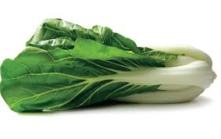
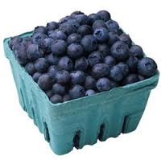
Economics: Supply & Demand
Which of these foods do you think farmers sell more of?
Bok choy
Blueberries
WHY?
Notes:
Which of these foods do you think the farmer sells more of?
Bok choy or blueberries?
Why?
The right answer is blueberries. Does anyone want to tell me why it is not bok choy?
Kids should explain:
Blueberries are more common. People know what blueberries are and how to use them.
Blueberries are more convenient. You can grab them and go! No need for cooking.
They are sweet. Most people love sweet flavors over any other flavors.
These are things farmers consider when growing certain foods. Factors like these help the farmer predict what the demand will be for their product.
They obviously don't want to grow items that won't have a strong demand from consumers. Why?
Because with low demand, the farmer would have to keep prices low and wouldn't make as much money. Or no one will buy the item, it will go bad, and the farmer still loses money.

Slide 9
Farm to School Benefits
Farmers have a new place to sell their local food!
YOU get to eat tasty, local, & healthy food!
Local farmers get to keep more $MONEY$
That $MONEY$ stays INSIDE the community!
Notes:
So what are the benefits of a farmer selling their products to your school?
1. Farmers have a new place to sell.
2. You get to eat tasty, healthy, local food.
3. Farmers get to keep more money.
4. That money stays inside the community.
Wait... how do farmers keep more money? What does it mean for money to stay inside the community?
Well let's take a look!

Slide 10
Notes:
So for you, as the consumer, you spend $1 on an apple. It makes a big difference where you buy this apple.
If you buy it from a local farmer (one from Lexington or Kentucky), almost half of that dollar will go back into the local community (Lexington or Kentucky).
But if you buy an apple from WalMart that came from Washington, only 15 cents of that dollar will go back into your community.
Why does that matter? What does it mean for money to stay in the local community?
It means better roads, hospitals, schools, teachers, etc!

Slide 11
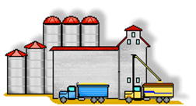
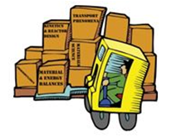
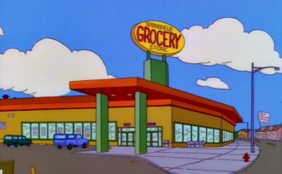
Economics: Supply Chain
Farmer
Farmer
Processor
School
VS.
Distributor
YOU!
Retailer
YOU!
Notes:
Money Activity:
Materials List: 10 fake $1 bills, 1 piece of fruit, paper signs for each role to hold or hang around their necks.
Call 6 children to the front of the room and pass out roles -- Farmer, Processor, Distributor, Retailer, School, or You (the Consumer).
Have the students first line up in order of the industrial food chain (School will sit out for now).
The Farmer passes the apple to the Consumer through all of the other students. As the apple goes down the line, briefly explain the role of each...
Farmer grows the fruit
Processor washes and packages it
Distributor transports it
Retailer is the store (I.e. Kroger, Walmart, etc)
Once the apple reaches the consumer, they then pass the money (whole $10) through the chain of students. Each student/role takes $2 and the Farmer should be left with $4.
Now repeat with the Farm to School chain of students (take out the Processor, Distributor, Retailer and add in School); the Farmer gets to keep $8.

Slide 12
Why can’t we always get all foods locally?
Can you grow bananas in KY? Oranges?
Notes:
Although buying local food from farmers is the ideal way to go. It's not always possible. Why?
1. Some things don't grow here – bananas, avocados, oranges, etc. We don’t have the right environment for some thins.
2. Most things don't grow all the time here. They have certain seasons.. Like pumpkins in the fall! Give more examples from the graph.
3. Sometimes local food can be more expensive when coming from smaller local farms and may not work for your family's budget.
HOWEVER, if each family in Kentucky could spend only $13 a week on local food, that would keep over $1 billion in our state each year!!

Slide 13
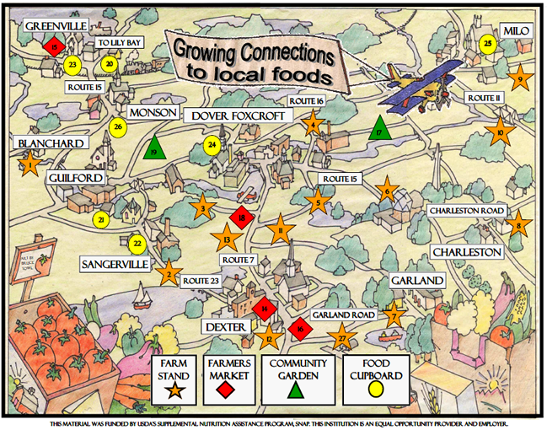
Do you know where to buy local?
Farmers Market
Farm stands
Some grocery stores
Gardens
Orchards
Farms
Food Banks

Slide 14
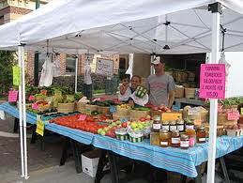
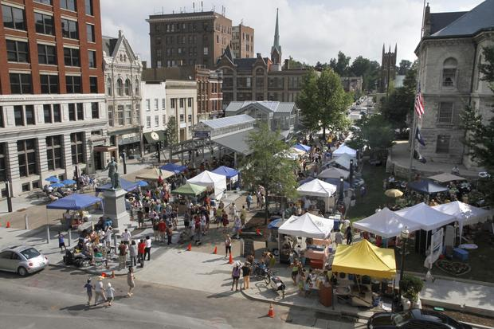
Have you been to the Farmers Market???

Slide 15
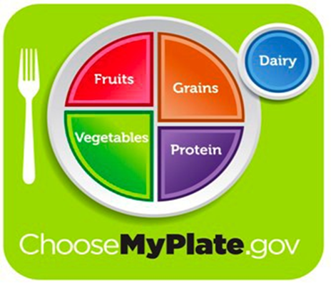
Human Health Benefits
Eating local produce helps you to eat all of the Nutrients your body needs
Eating local foods helps minimize Nutrient Degradation
Is an apple from Washington or Kentucky Healthier?
The longer food travels from farm
to consumer, the more nutrients
it loses.
Notes:
Some other benefits of local food include... YOUR HEALTH!!
(Read the slide and define the following:)
Nutrients are “ingredients” of food or what foods are made of. There are 6 nutrient groups: FAT, CARBOHYDRATE, PROTEIN, VITAMINS, MINERALS, WATER.
Nutrient Degradation: When vitamins and minerals are lost by time, heat, light and air exposure. Focus on how local foods don’t suffer from this.
Fresh produce needs to fully ripen on the vine to get the most nutrients The longer they are in “transit” from farm to consumer, the more nutrients they loose.

Slide 16
Environmental Benefits
Local food is more sustainable
Less transportation and packaging
Locally grown food finds ways to make farms more profitable
Imported food uses more fossil fuels
This potentially contributes to global climate change
Has to travel farther to get to you
Notes:
Buying and eating local food also benefits.... THE ENVIRONMENT!
Since food is grown close to home, local food production…..
Uses more sustainable agriculture--- a system of food and production that protects the environment. This meaning it reduces soil erosion, uses chemicals responsibly, finds ways to make farms profitable, invests in rural communities, and keeps food prices reasonable.
Less transportation- Since food is grown close, less money will be used for transportation cost and less energy is used moving the food.
Less pesticide use (not all local is organic)
Involves less environmentally harmful equipment and practices- Because majority of the foods are grown on small family farms.
Imported Food
Usually grown farther away, and is less sustainable…
Dependent on fossil fuels-
Potentially more chemical fertilizers and pesticides (made with fossil fuels).

